Slide 1
Enabling business to overdeliver
on their sustainability promises
CHECK OUT THE SPEAKER NOTES FOR EXTRA INFO

Slide 2
PROBLEM: EU LEGISLATION (CSRD)
Materials Accounting is crucial to remain competitive & comply with mandatory EU-legislation
Only 2% of businesses globally is ready & materials accounting is biggest issue
1
Material composition data rarely available but essential for transparency
2
Green claims demand precise & verifiable data, posing reputation & legal risks
3
Materials are the key to meet carbon goals. 66% of emissions are linked to resource extraction & processing
ESRS E5-4: resource inflows: “ … percentage of reused, or recycled, and renewable input materials used to manufacture[...] products and services”
Notes:
The demand for materials will grow by almost 3 times in the next 20 years. This will dictate the market and result in higher prices. The companies that understand their material flows best; will be able to translate this into a competitive advantage. Because of their knowledge they can recover materials they already bought and use them again, they can predict risks and start scenario-planning now and start looking for alternatives; or ways to use less of the materials that are under the most pressure, avoid generating waste and more.
— NVDL —
Goals & legislation
---
Impact of action
From virgin to non-virgin = Avoided GHG
Improve circular outflow (step 5) > importance of Actual Recovery
Revenue linked circularity (green washing)

Slide 3
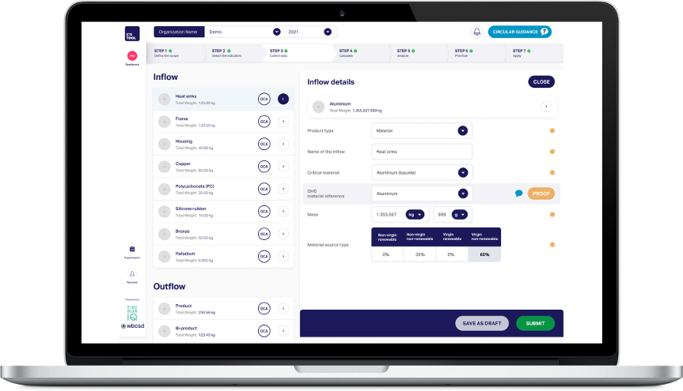
Circular Transition Indicators (CTI)
=
GhG protocol for circular economy
CTI is fully aligned with disclosure requirements in CSRD
GRI 301, ISO 14021 & ISO 20400
LINK TO KPMG & WBCSD WHITE PAPER HERE
Notes:
CTI is the recognized measurement approach for materials accounting in the circular economy. When you use our software.
You generate powerful insights based on minimum data-inputs. AND meet upcoming disclosure requirements like ISO, GRI and CSRD

Slide 4
Our approach
Tailored Assessment Scope to ESRS E5: Collaboratively determine the most suitable assessment scope for your company, ensuring an impactful baseline assessment aligned with ESRS E5;.
Flexible Assessment Levels: Choose from company-, product-, or facility-level assessments to meet your voluntary reporting needs and goals, supported by Circular IQ every step of the way.
Comprehensive Support: Receive hands-on support & expert-training throughout the baseline assessment process, including analytics & scenario-planning capabilities transferred to your team for building in-house capacity & expertise.
Data Gap Resolution Assistance: Utilize our expertise to identify and prioritize data gaps for meeting reporting requirements. We guide you in resolving these gaps efficiently, leveraging robust proxy data that meets audit requirements, providing clarity on performance and actionable insights for immediate data improvement actions.
Guided Implementation: Benefit from training sessions & progress check-ins to understand CTI software and framework principles, aiding in defining assessment scopes and setups based on materiality.

Slide 5
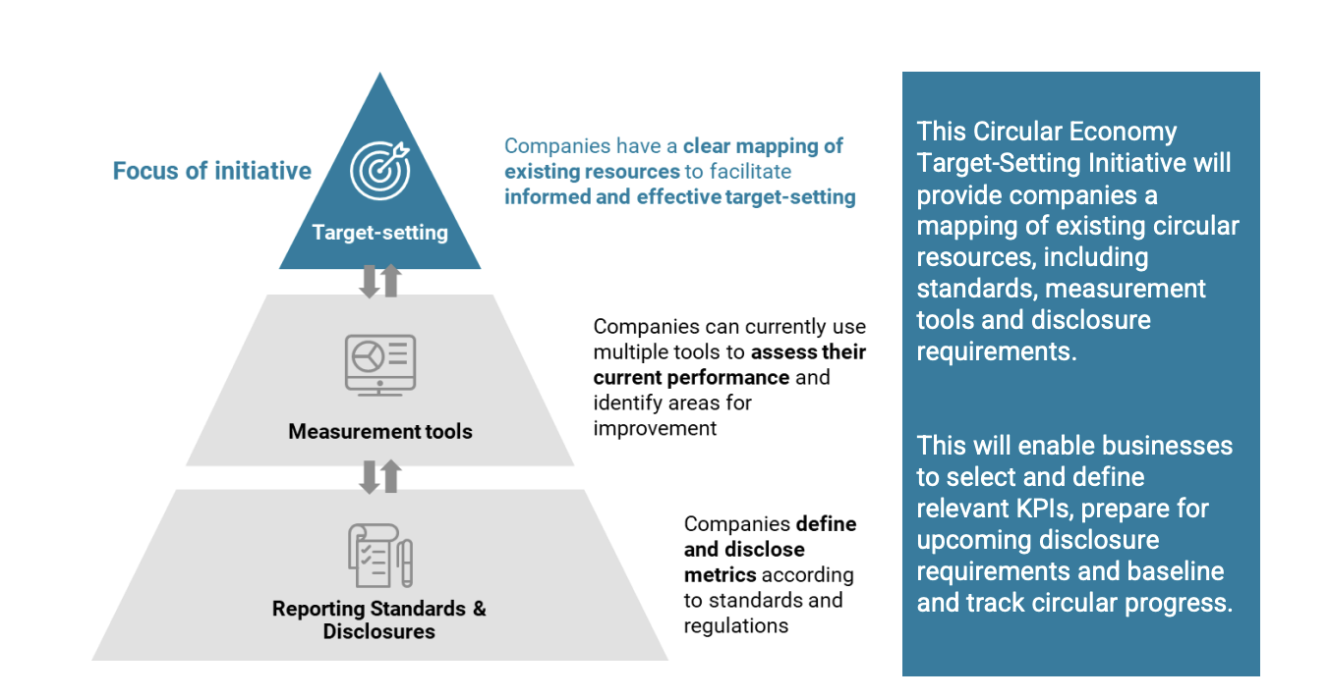
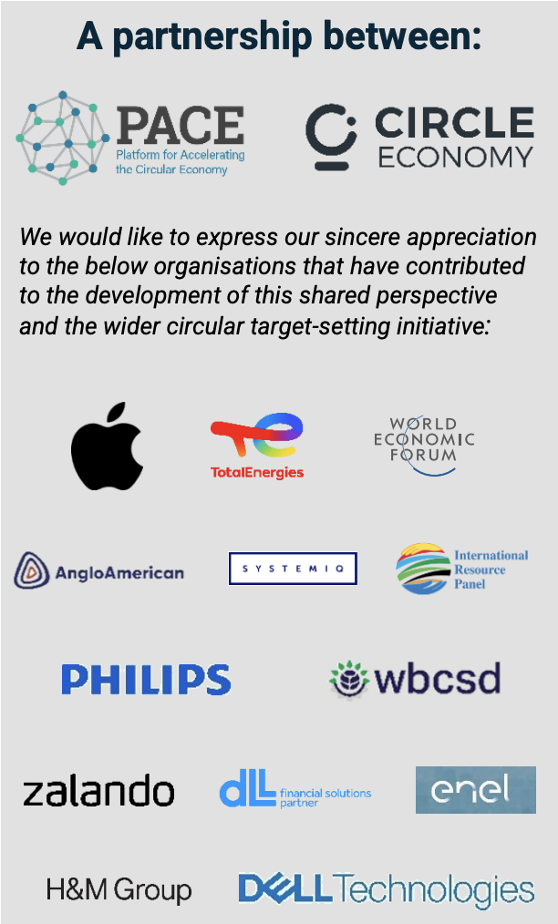
CSRD-compliance simplified
3
CSRD
Compliance
KPI-dashboard
Mandatory Disclosure
Impact Improvement
Materials drive:
E1 - climate change / scope 3
E2 - pollution
E3 - water & marine resources
E4 - biodiversity & ecosystems
Linked to: S1 - S4 and G1
2
1
Materials Accounting & ESRS E5-compliant baseline
Leveraging CTI Tool

Slide 6
Our Magic
Best in class SaaS solution & first mover in emerging market
return on investment
(< 4 months)
Up & running in minutes,
Actionable insights & informed decisions
integrates seamlessly
Enhance Efficiency &
Data quality
Notes:
CTI Tool is a SaaS-solution. It is Up & running in minutes, offers seamless integrations, enhanced efficiency and elevated data quality. The result? A return on investment, in 4 months.

Slide 7
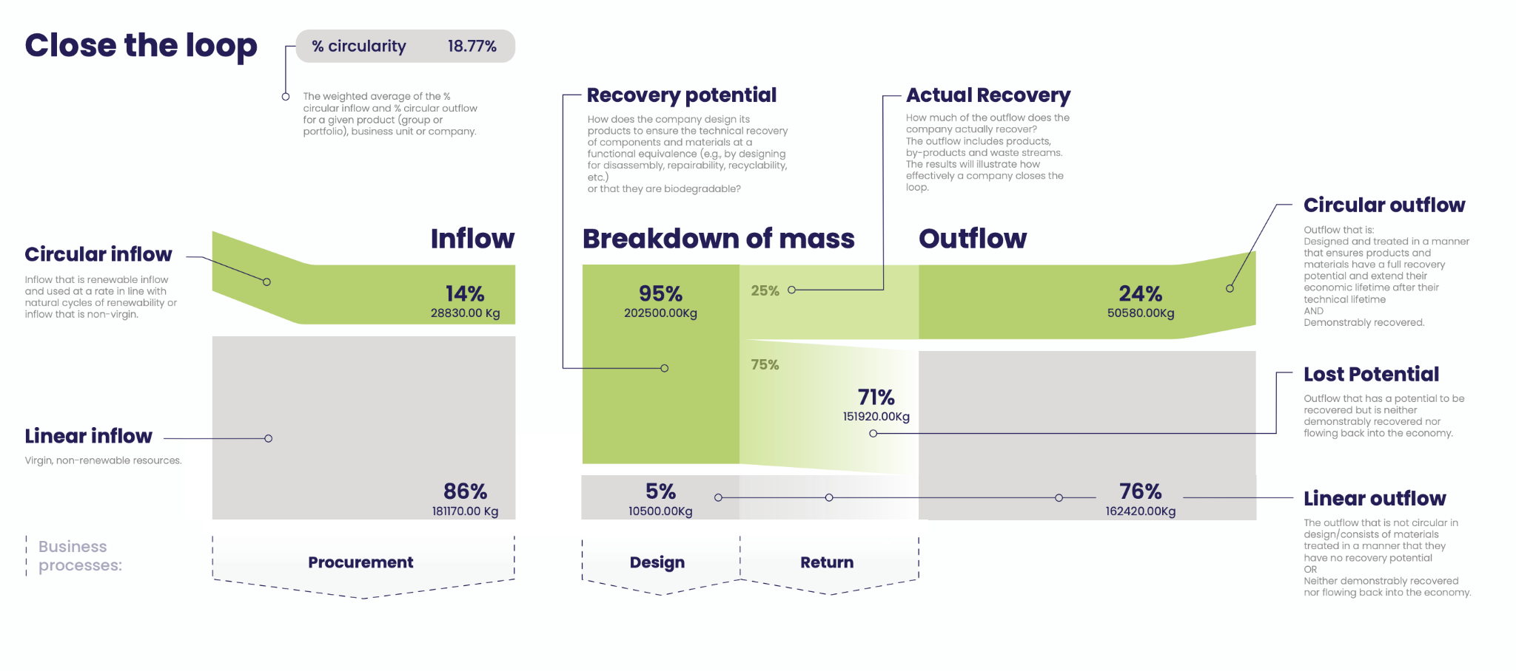
CTI Framework Definitions & Logic
Notes:
This slide visualizes the core of the CTI. The Close The Loop indicator. The best way to explain the slide is by comparing it to financial reporting; where you keep track of monetary income and expenses in € or $. CTI is the same but then for materials. You classify incoming materials (inflow) and materials that flow out of the scope of your assessment (outflow) and classify them as linear or circular. Very similar to bookkeeping software where you’d classify office expenses and travel expenses. This visual shows a headline KPI (% circularity), and 3 enabling KPI’s that can be tracked using minimum data. The 3 enabling KPI’s are: - Circular inflow - Circular outflow - Lost potential The information these indicators generate gfeeds directly into operational processes like: procurement, design etc.

Slide 8
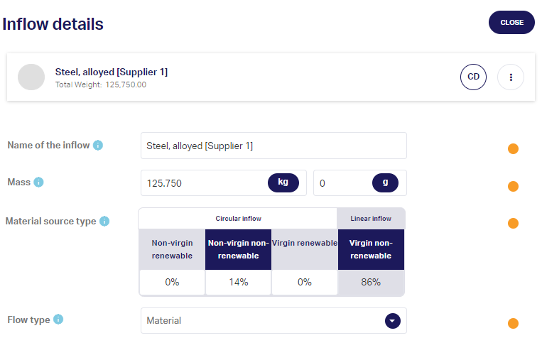
Data Collection: CTI Tool - inflow
Notes:
This slide shows how few data-points are required to generate clarity on circular inflow. The right side shows a screenshot right-out-of-CTI Tool. All you need to track is: - material name - weight - composition data (% recycled, renewable content) - flow type is for improving analytics capabilities and differentiating product from packaging data. For all data-points you can upload proof if you choose to do so

Slide 9
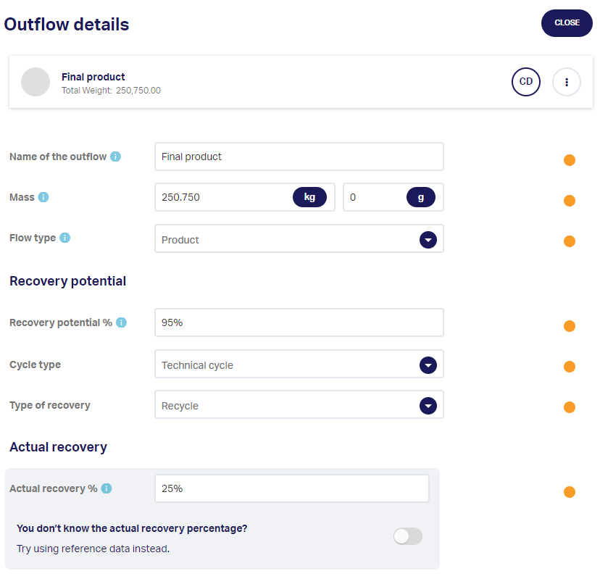
Data Collection: CTI Tool - outflow
Notes:
This slide shows how few data-points are required to generate clarity on circular outflow. The right side shows a screenshot right-out-of-CTI Tool. All you need to track is: - material name - weight - flow type is for improving analytics capabilities and differentiating product from packaging data. - recovery potential and the type of cycle that’s applicable - Actual recovery data can be generated via a third-party database or uploaded based on company data
For all data-points you can upload proof if you choose to do so

Slide 10
Road Map & Timeline
Onboarding
Baseline assessment
ESRS E5 Clarity
Weeks 1-4
Weeks 5-8
Weeks 9-12
Align on detailed scope, approach and meetings
Access to CTI Tool & methodology training
Align company dataset for CTI
Clarity on company’s materiality
Outline the reporting needs
Collect data and upload baselines into CTI Tool
Map data availability and document data sources
Fill possible data gaps with proxy data or validated assumptions
Create baseline assessment
Run improvement scenario analysis
Receive CTI report with all required comparisons and aggregations
CTI’s inflow circularity covers E5-4
CTI’s outflow circularity covers E5-5
Goal setting covers E5-3
CTI Tool generates narrative for IRO-1
Project team ready to scale process and run assessments independently
Circular IQ supports the team
Notes:
This slide shows that you can expect your first results 12 weeks into the project. Explaining what the first weeks look like; what will be worked on to give a better idea of the nature of the project that you intend to start and the capacity it will require; but mostly showcasing that there is a clear plan. The goal of the Kickstarter is that the team involved learns how to conduct their own assessments and use CTI Tool to generate the results they are looking for by themselves after completing the process. Circular IQ’s support hours can then be used to discuss account set-up and how to best leverage analytics and reporting capabilities the tool offers, plus onboarding other teams in the company.

Slide 11
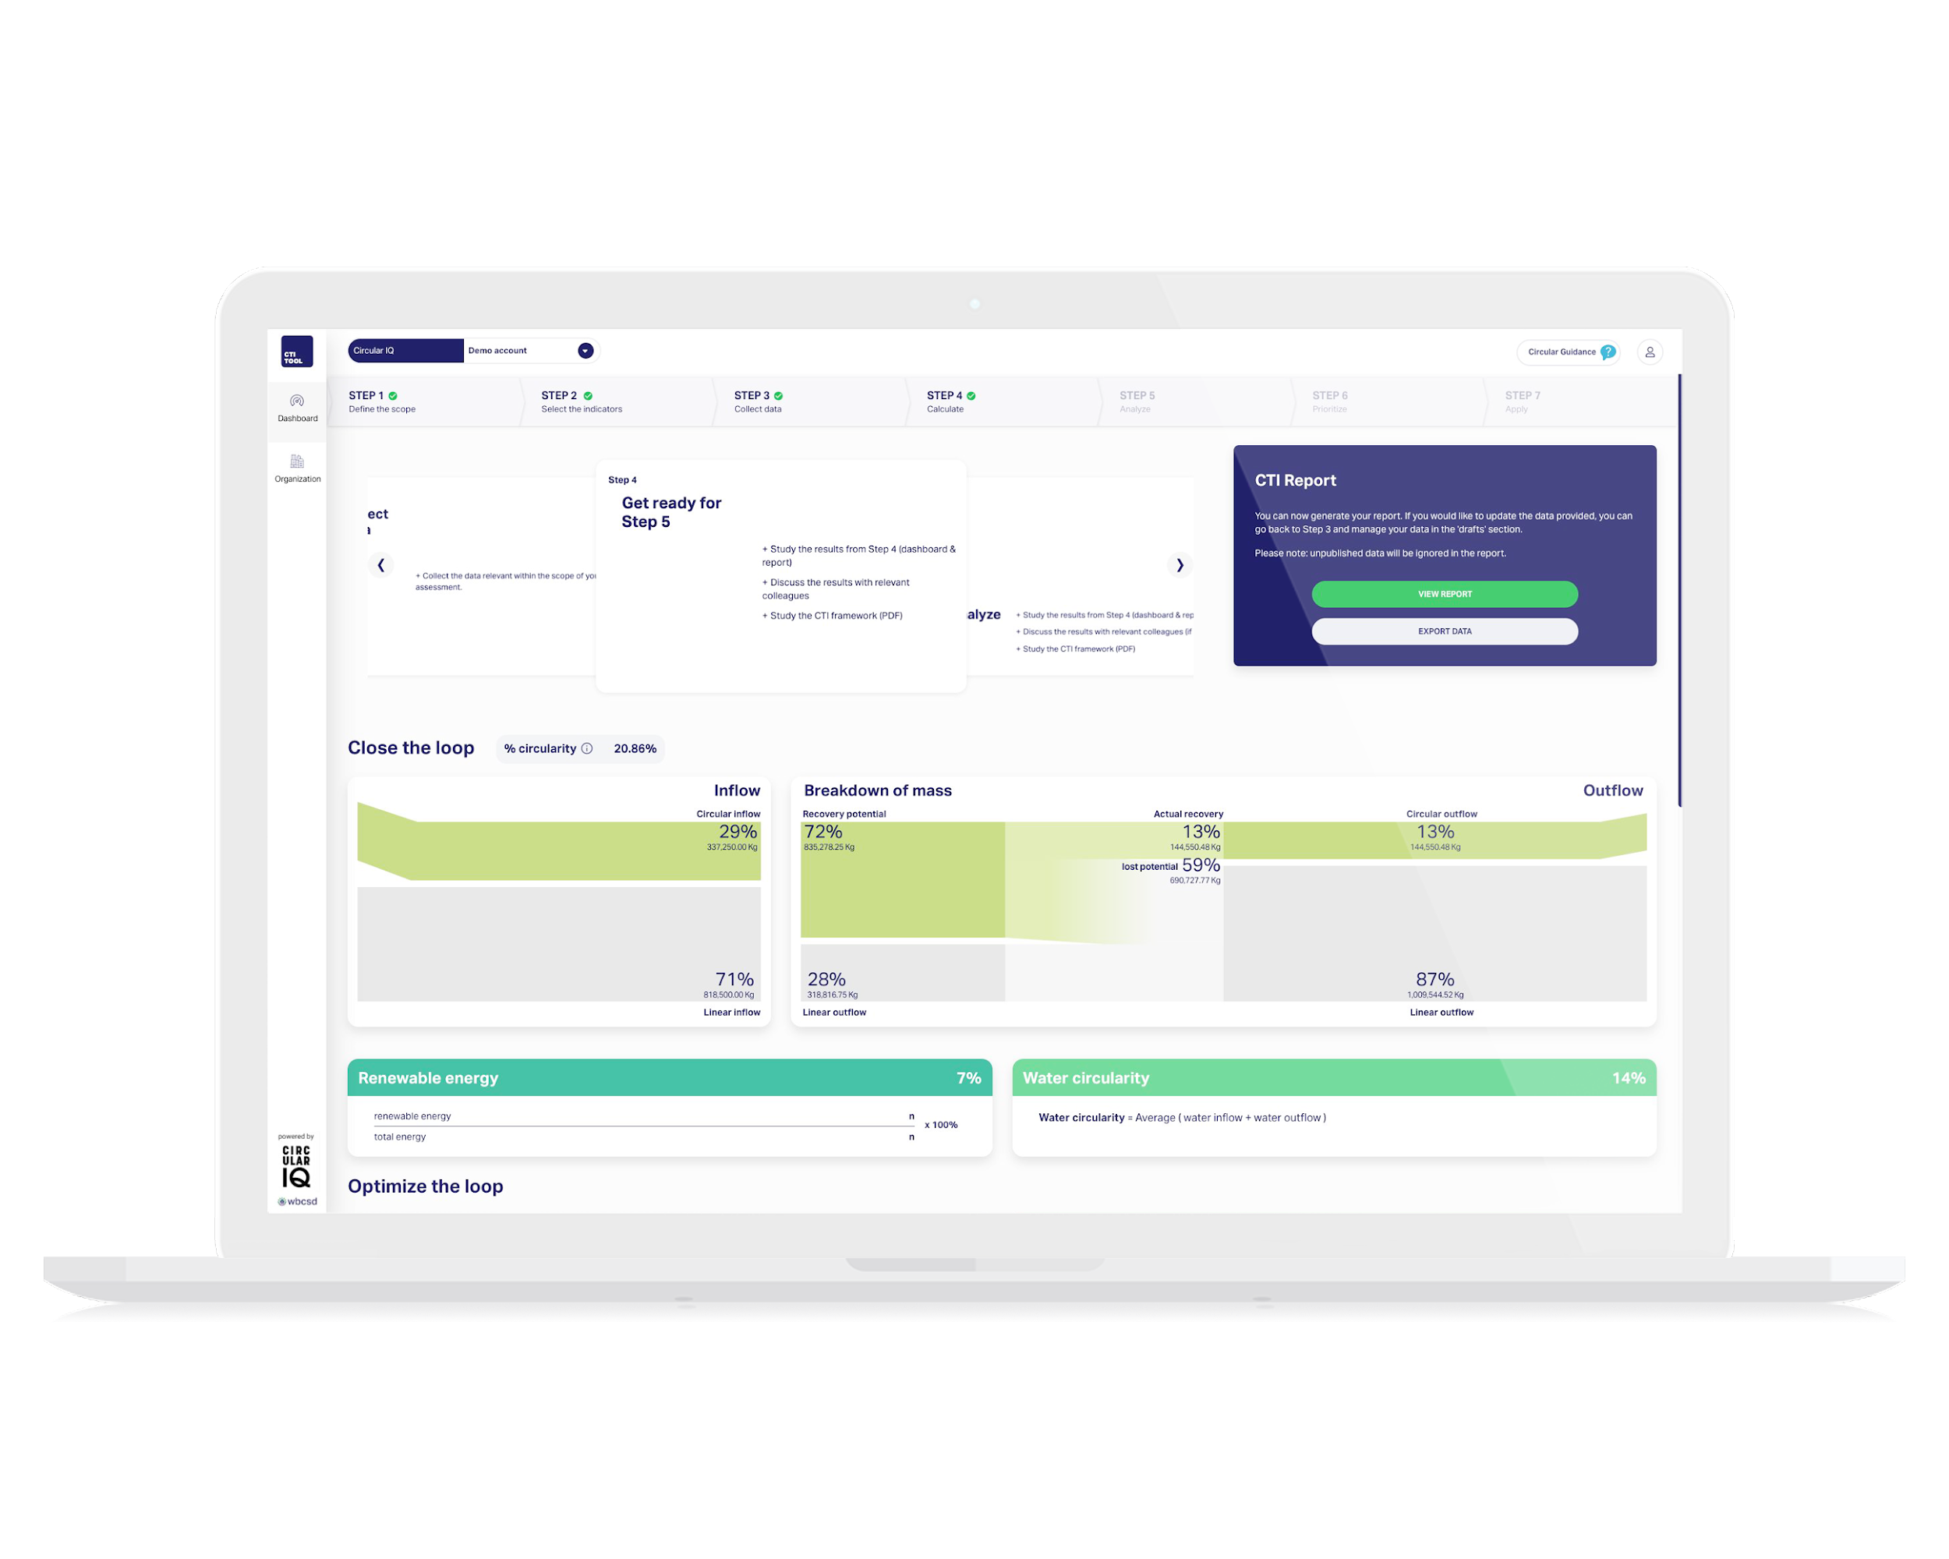
Set-up & deliverables
What’s needed from your team
Access to relevant datasets that can be used for baseline
30 hours of time from project lead (15h for other stakeholders)
Max. 10 hours from IT resources to understand data architecture
Deliverables
ESRS E5 baseline clarity via CTI dataset & tooling
Clarity on current circular performance & key drivers
In-depth training of CTI methodology & software tool
Kickstarter-Program
Risks & Opportunities regarding data cleared-up
Ability to leverage Circular IQ’s expertise to evaluate & shortlist improvement strategies
Clarification on how to leverage CTI Tool-output to support CSRD/ ESRS-E5 reporting requirements input
Notes:
This slide shows what value is delivered and sheds light on the commitment required form the company-team.

Slide 12
Top Customers
Trusted by industry leaders in the global marketplace
Notes:
Circular IQ works with sustainability leaders in the top companies across many sectors worldwide.

Slide 13
Help us empower you to over-deliver on your sustainability goals
CLICK HERE FOR A FREE ACCOUNT
Roy Vercoulen | roy@circular-iq.com | +31 6 5246 1128
Notes:
Feel free to reach out to Roy in case of any questions

