Slide 1

Enabling business to
overdeliver
on their sustainability promises
CHECK OUT THE SPEAKER NOTES FOR EXTRA INFO

Slide 2


Why taking action now is crucial
Lack of data is no excuse anymore; improving data has to become a priority
1
2
Seizing first mover advantage results in higher than expected financial benefits
3
Acting now increases the opportunities of complying with CSRD in time; delaying the decision increases exposure to risks
Notes:
The demand for materials will grow by almost 3 times in the next 20 years. This will dictate the market and result in higher prices. The companies that understand their material flows best; will be able to translate this into a competitive advantage.
Some companies delay or postpone action because they don’t feel confident about their ability to generate the right data. Starting with CTI on a specific project is the fastest way to identify data-gaps and actively work on improving data availability and quality. This is needed, because with CSRD coming disclosure of material composition data is becoming mandatory.
Research shows that pacemakers are 1.8 times more likely to seize higher than expected financial results and over-deliver on their goals. This is clear evidence of first-mover advantages.
CTI Tool enables its users to assess & predict risks and start scenario-planning now. It enables objective evaluation of alternative materials; or ways to use less of the materials that are under the most pressure, avoid generating waste and more.

Slide 3











Created CTI Framework
GhG Protocol is the standard globally
CTI Framework
CTI is the recognized measurement approach for the circular economy
involved
from the start
In alignment with:
Notes:
WBCSD has a big reputation in standard setting. Launching the GhG-protocol before. For CTI they worked together with 30 companies, including our clients Honda, Whirlpool, and Microsoft. They aligned on definitions with all key-stakeholders. From EMF to GRI and C2C.
It resulted in a reporting standard that is industry and value chain position agnostic. That allows users to generate powerful insights based on minimum data-inputs AND feeding reporting needs. The standard and its definitions are now landing in new ISO-standards as well as the EU’s Corporate Sustainability Reporting Directive (CSRD)

Slide 4

Proposal overview
Circular IQ will support your project team in selecting the right assessment scope and indicator modules to deliver an impactful proof of Concept within Company and immediately showcase baseline performance on a set of key circularity performance indicators.
Together with you, we will select an assessment scope of your choice. Circular IQ will support your company in executing on the delivery, providing hands-on support all steps of the way and transferring analytics and scenario-planning capabilities to your team. Establishing clarity on baseline performance & improvement scenarios.
You purchase a CTI Tool Premium membership for 12 months including a kickstarter (€ 27.500 ex VAT). With this package all costs for the first 12 months inside the scope of this proposal are covered (50 assessments, all support needed for completing 1 kickstarter, plus 25 additional expert support hours*).
*https://ctitool.com/pricing/
Notes:
This slide contains an overview of the scope of the CTI Tool Premium membership for the first 12 months; highlighting the added value you can expect from the Kickstarter process as well as detailing the support that is part of the offering.

Slide 5

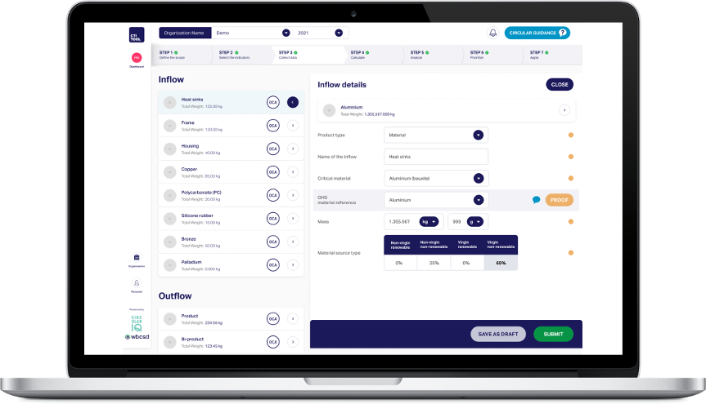


CTI is fully aligned with requirements from CSRD.
LINK HERE
GRI 301, ISO 14021 & ISO 20400
Notes:
CTI is the recognized measurement approach for materials accounting in the circular economy. When you use our software. You generate powerful insights based on minimum data-inputs. AND meet upcoming disclosure requirements like ISO, GRI and CSRD. Behind the link you can find a report from KPMG that outlines how ESRS-E5 and CTI are completely aligned, while at the same time research from PACE and the Circular Economy Indicator Coalition shows that CTI is the recommend measurement approach for the KPI’s that the coalition identified. Finally; CTI enables its users to leverage the data they collect for mandatory disclosure (CSRD), as well as voluntary reporting standards (ISO & GRI).

Slide 6
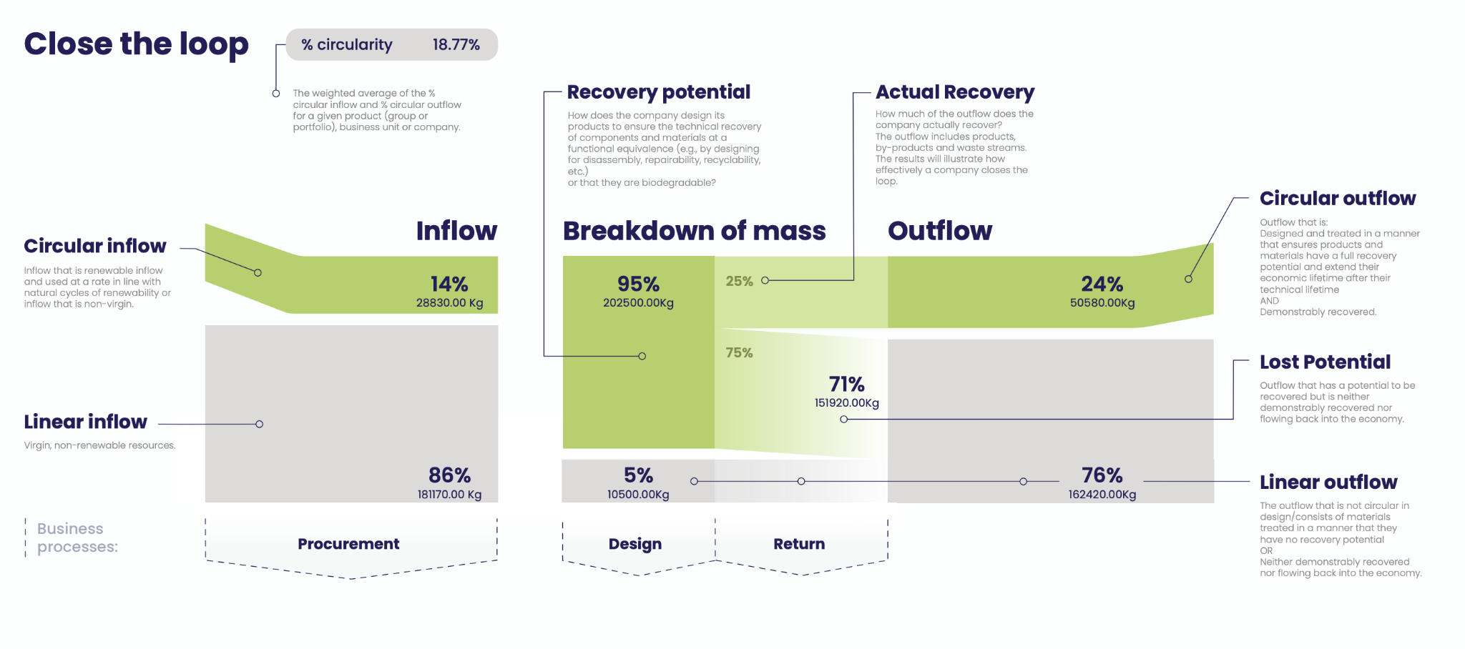
CTI Framework Definitions & Logic
Notes:
This slide visualizes the core of the CTI. The Close The Loop indicator. The best way to explain the slide is by comparing it to financial reporting; where you keep track of monetary income and expenses in € or $. CTI is the same but then for materials. You classify incoming materials (inflow) and materials that flow out of the scope of your assessment (outflow) and classify them as linear or circular. Very similar to bookkeeping software where you’d classify office expenses and travel expenses.
This visual shows a headline KPI (% circularity), and 3 enabling KPI’s that can be tracked using minimum data. The 3 enabling KPI’s are:
- Circular inflow
- Circular outflow
- Lost potential
The information these indicators generate gfeeds directly into operational processes like: procurement, design etc.

Slide 7
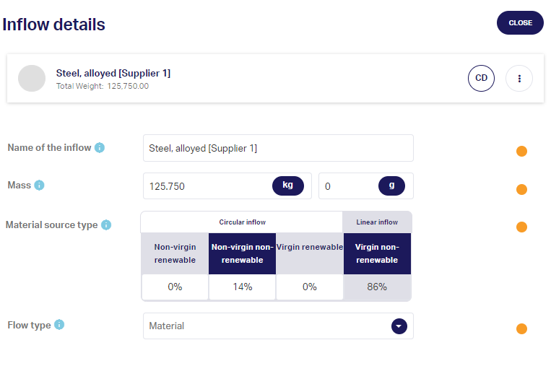
Data Collection: CTI Tool - inflow
Notes:
This slide shows how few data-points are required to generate clarity on circular inflow. The right side shows a screenshot right-out-of-CTI Tool. All you need to track is:
- material name
- weight
- composition data (% recycled, renewable content)
- flow type is for improving analytics capabilities and differentiating product from packaging data. For all data-points you can upload proof if you choose to do so

Slide 8
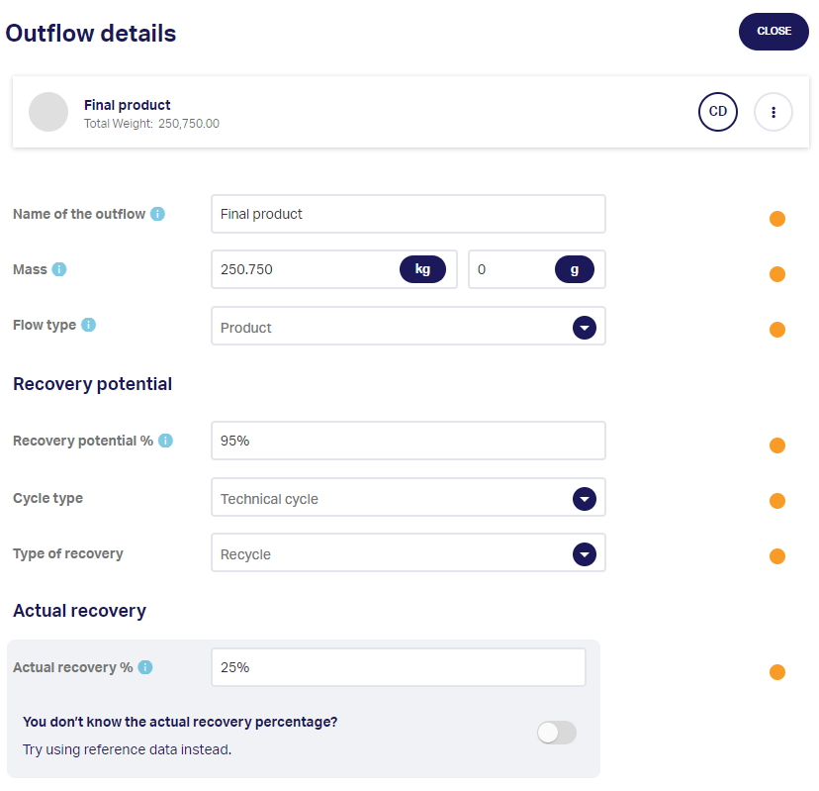
Data Collection: CTI Tool - outflow
Notes:
This slide shows how few data-points are required to generate clarity on circular outflow. The right side shows a screenshot right-out-of-CTI Tool. All you need to track is:
- material name
- weight
- flow type is for improving analytics capabilities and differentiating product from packaging data.
- recovery potential and the type of cycle that’s applicable
- Actual recovery data can be generated via a third-party database or uploaded based on company data
For all data-points you can upload proof if you choose to do so

Slide 9
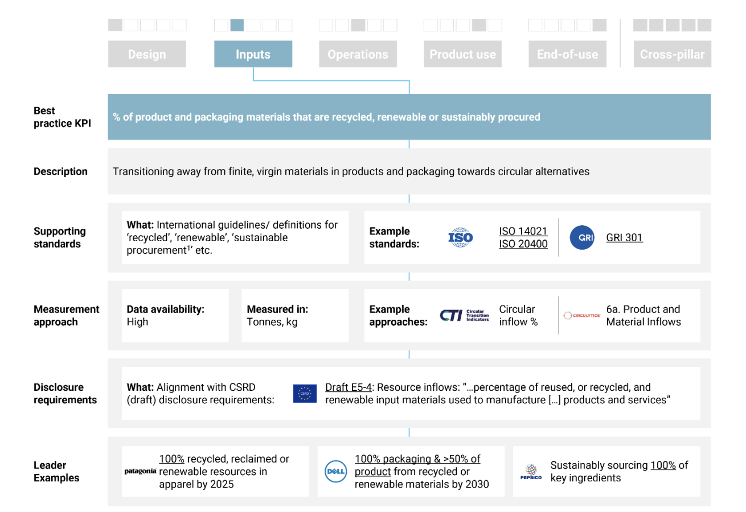

Standards*
Questionnaire
CTI Tool
Tools
Notes:
This slide comes from PACE-research together with their Circular Economy Indicator Coalition. On the top it shows an example of a KPI that could be relevant for your company as well. Then it shows the description/ job of the KPI.
Subsequently the supporting standards for voluntary reporting are listed that the KPI aligns with (in this case ISO & GRI). Then it highlights what is a recommended approach for measuring performance against the KPI, as well as an assessment of data-availability for the data required. This is where CTI and CTI Tool are included,
Then its shows alignment with upcoming mandatory disclosures; in this case CSRD; plus some examples of other companies that have adopted this specific KPI. It offers a logic for talking about how to embed KPI’s as well as clearly mentioning CTI Tool’s added value as measurement tooling to use to support your KPI-dashboard. More info here: https://pacecircular.org/sites/default/files/2023-02/FV_CEIC_Target%20activation%20guides_17.02.23.pdf

Slide 10






Our Magic
Best in class SaaS solution & first mover in emerging market
return on investment
(< 4 months)
Up & running in minutes,
Actionable insights & informed decisions
integrates seamlessly
Enhance Efficiency &
Data quality
Notes:
CTI Tool is a SaaS-solution. It is Up & running in minutes, offers seamless integrations, enhanced efficiency and elevated data quality. The result? A return on investment, in 4 months.

Slide 11
Kickstarter timeline
Kick-off
Step 1 & 2 in CTI
Align company dataset to CTI
Access to CTI Tool & training
Access to selected dataset
Discuss first result
Analyze main performance drivers
Compare packaging categories
Learn where biggest impact is
Select improvement scenarios
Discuss individually w. company teams
Identify opportunities for iterating improvement strategies & follow-up actions
Week 1
Week 4
Week 8
Week 2
Week 6
Week 12
Clarity on dataset & indicators
Fist analysis of dataset (internally)
Understand packaging flows impacts
Align on assessment architecture and indicators
Shortlist & compare scenarios
Run scenario analyses and possibly adjusted dataset;
Come up with a shortlist of improvement actions
Establish clarity on expected KPI-performance increase
Final check & delivery
Improvements final and presented to mgt.
Team equipped to run next project
Kickstarter completed
Notes:
This slide shows that you can expect your first results 12 weeks into the project. Explaining what the first weeks look like; what will be worked on to give a better idea of the nature of the project that you intend to start and the capacity it will require; but mostly showcasing that there is a clear plan. The goal of the Kickstarter is that the team involved learns how to conduct their own assessments and use CTI Tool to generate the results they are looking for by themselves after completing the process. Circular IQ’s support hours can then be used to discuss account set-up and how to best leverage analytics and reporting capabilities the tool offers, plus onboarding other teams in the company.

Slide 12
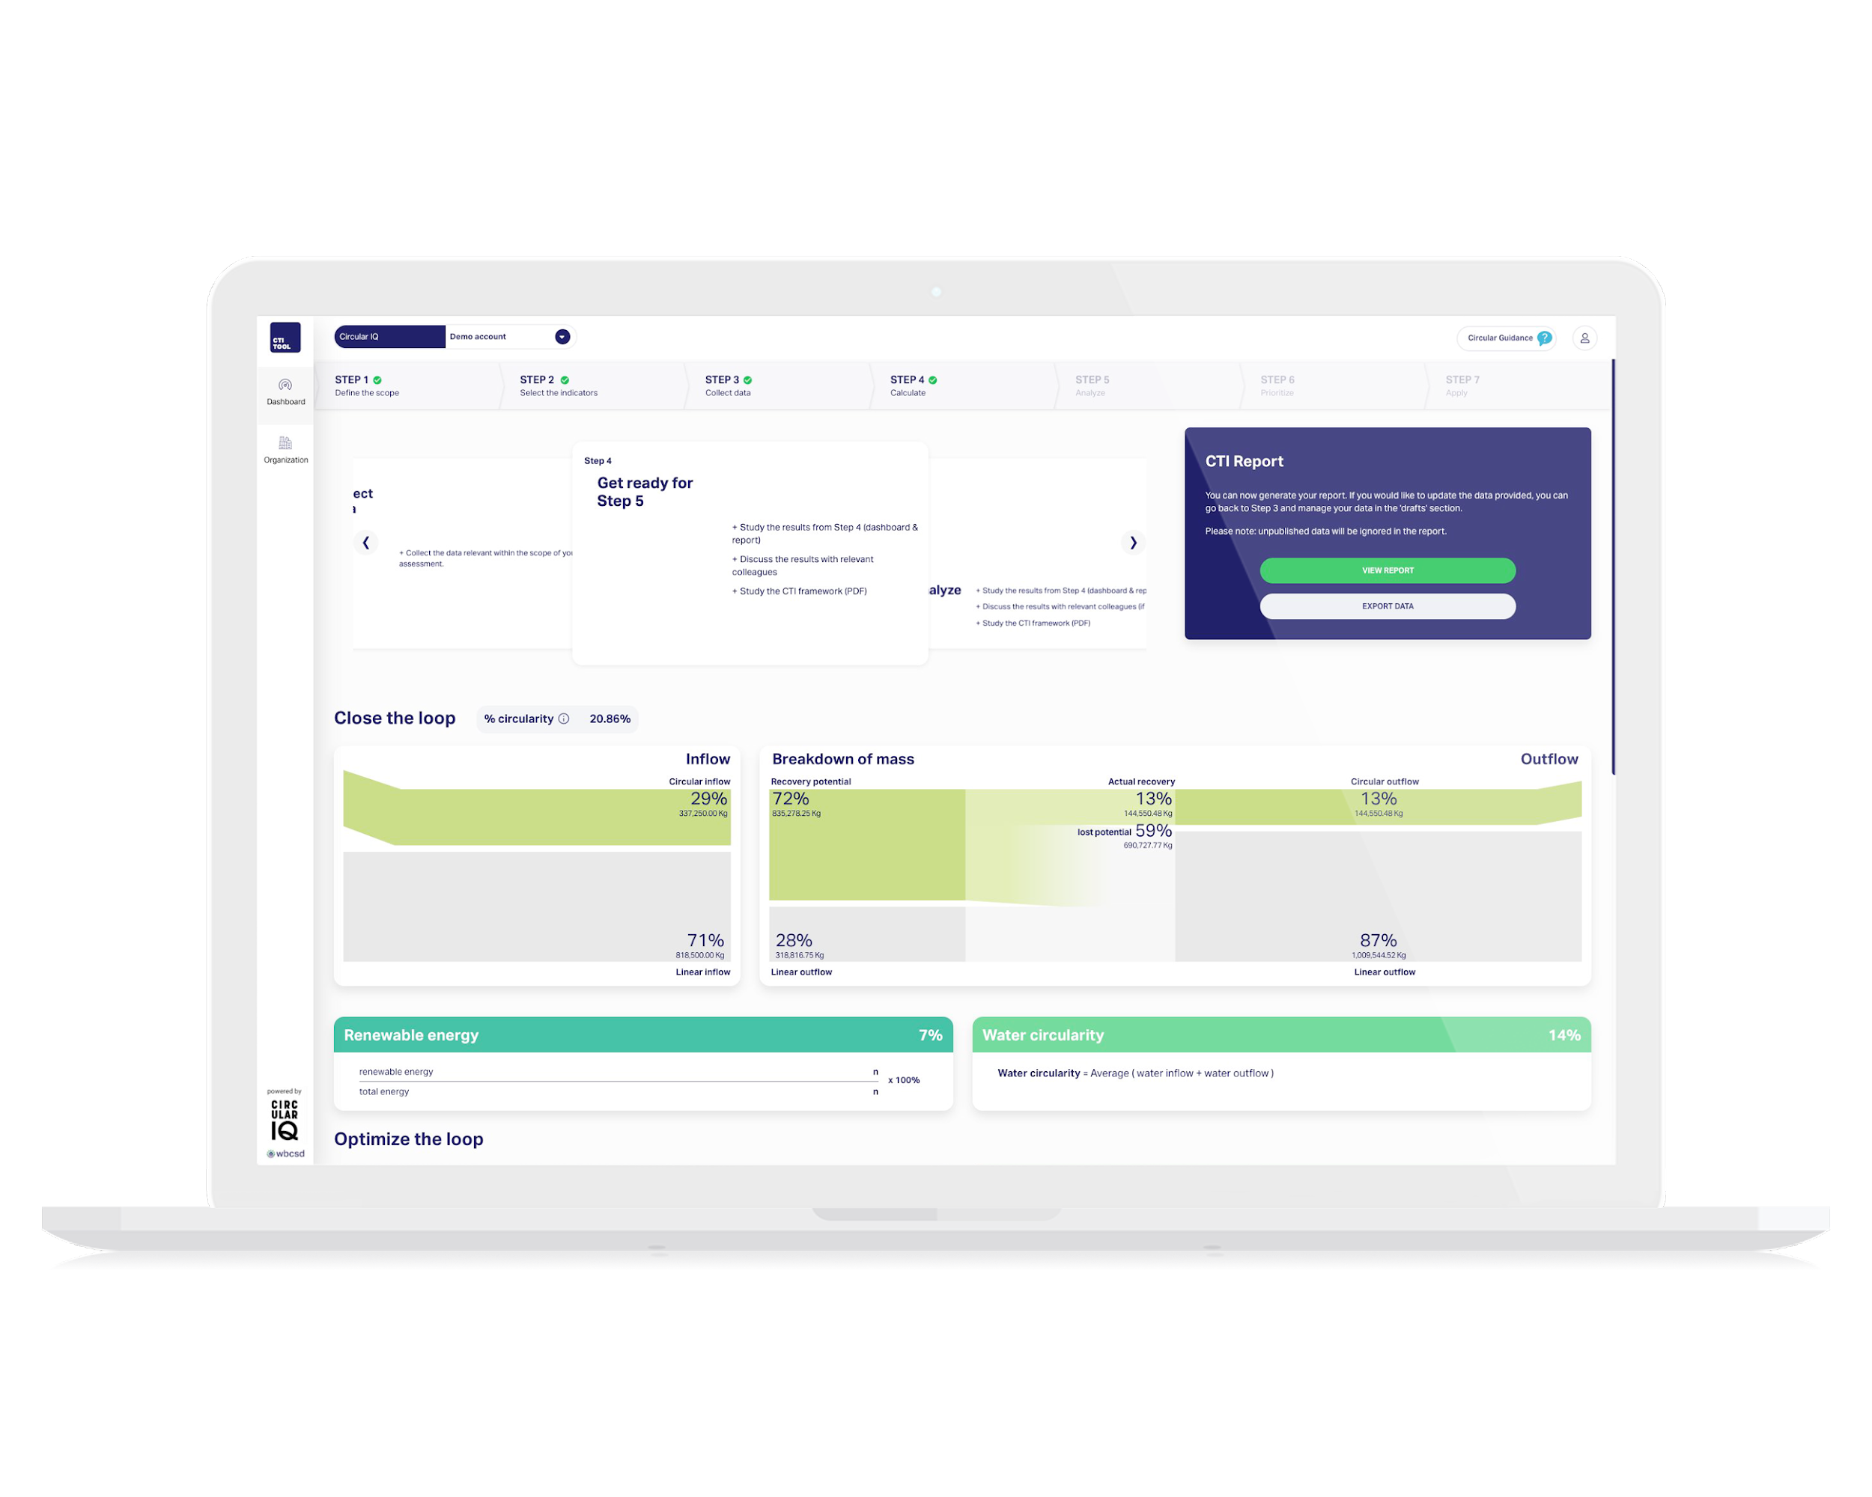
Set-up & deliverables
What’s needed from your team
Access to relevant dataset that can be used for assessments
20 hours of time from project lead (10h for other stakeholders)
Max. 4 hours from IT resources to understand data architecture
Deliverables
CTI Tool account with Pro Dashboard
Clarity on current circular performance & key drivers (baseline assessment)
In-depth training of CTI methodology & software tool
Kickstarter-Program
Upload of circularity targets into your account
The ability to leverage Circular IQ’s expertise to evaluate & shortlist improvement strategies
Clarification on how to leverage CTI Tool-output to support CSRD/ ESRS-E5 reporting requirements input
Notes:
This slide shows what value is delivered and sheds light on the commitment required form the company-team.

Slide 13















Top Customers
Trusted by industry leaders in the global marketplace
Notes:
Circular IQ works with sustainability leaders in the top companies across many sectors worldwide.

Slide 14
Help us empower you to over-deliver on your sustainability goals
CLICK HERE FOR A FREE ACCOUNT
Roy Vercoulen | roy@circular-iq.com | +31 6 5246 1128
Notes:
Feel free to reach out to Roy in case of any questions

